Slide 1
British Airways
Predicting customer buying behaviour using Random Forest Model

Slide 2
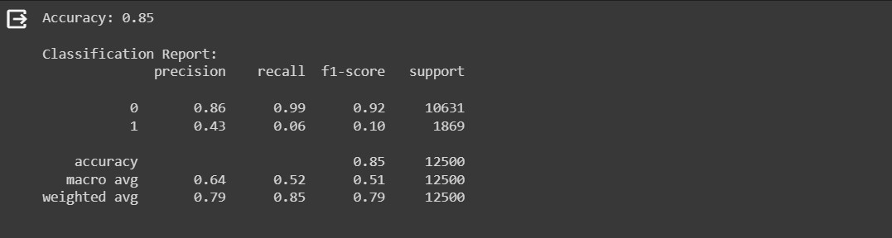
This shows the Accuracy of the model, The precission, recall, f1-score of the model

Slide 3
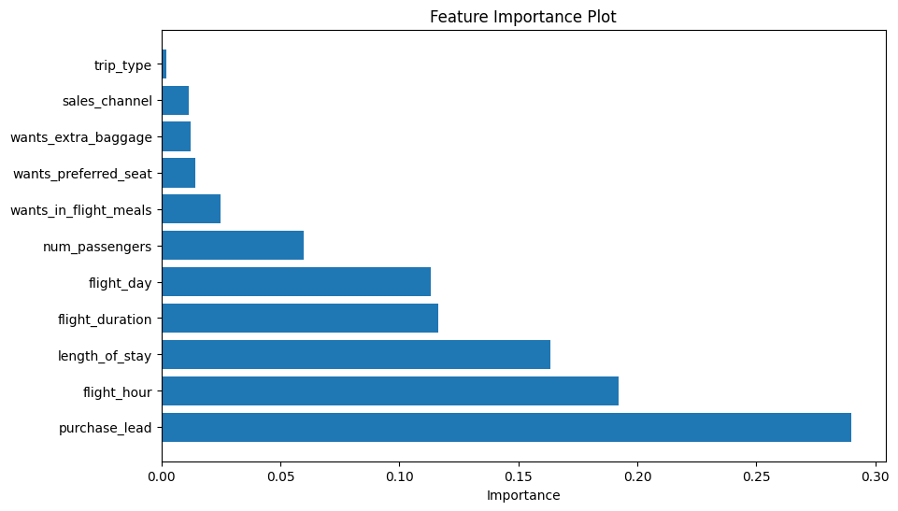
The graphs shows the feature and it’s importance for training the model

Slide 4
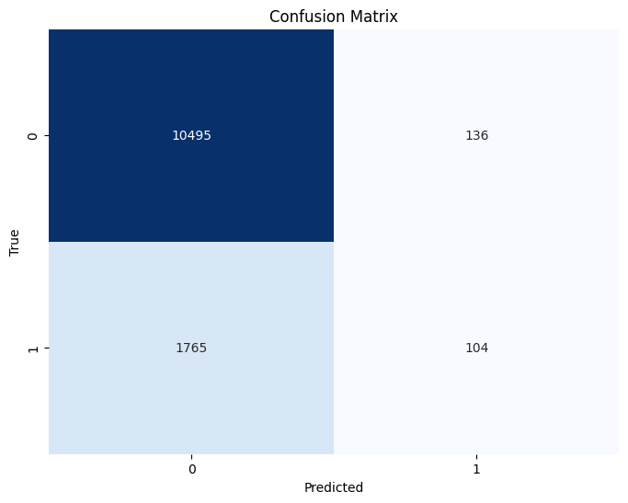
Confusion Matrix showing the Predicting how much the model positively and falsely

Slide 5
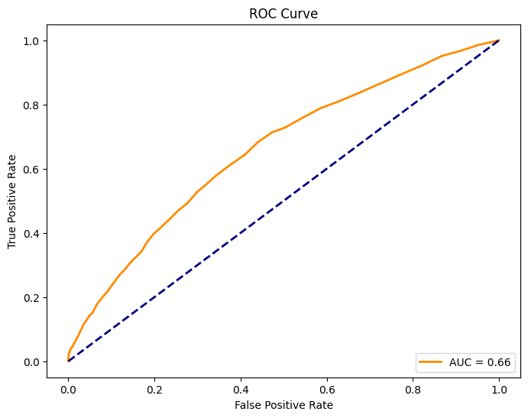
The Roc Curve of the model

